Slide 1

Fundamentals of API Security with Python
PyCon US 2024 Tutorial
May 16, 2024
José Haro Peralta
microapis.io

Slide 2
Agenda
Introduction and current state of API security
API authentication and authorization
Working with JWTs
OWASP top 10 API threats
API security testing

Slide 3
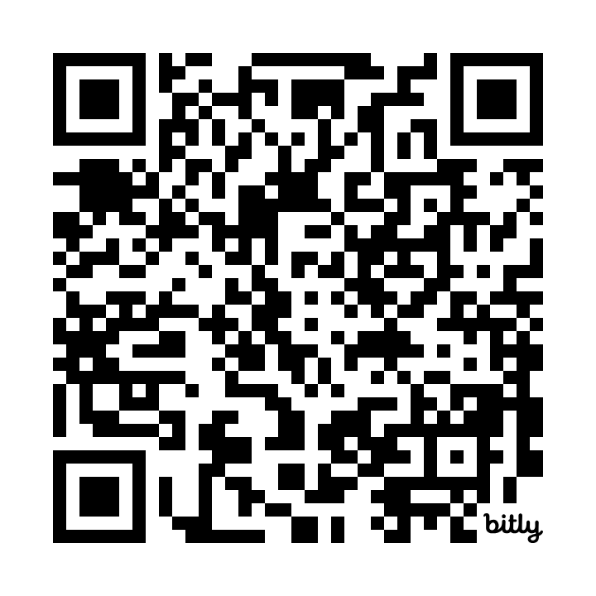
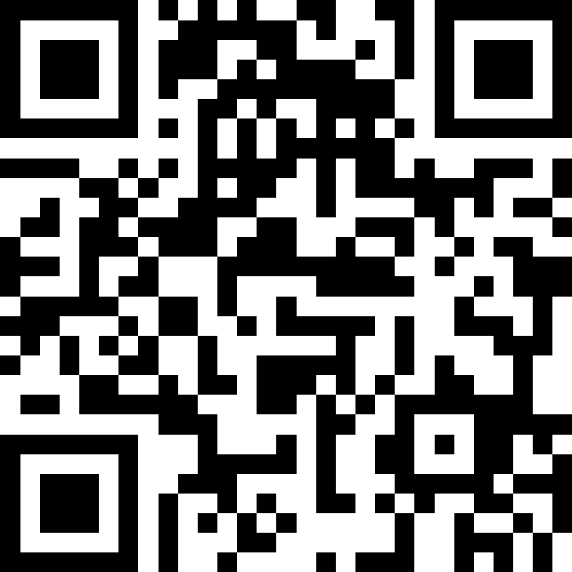
Resources
Reference doc: https://bit.ly/pyconus24apisec
Repo: https://github.com/abunuwas/pycon-us-2024
Polls: https://app.sli.do/event/aufvswCwNZAsYcZmfuCHMk

Slide 4
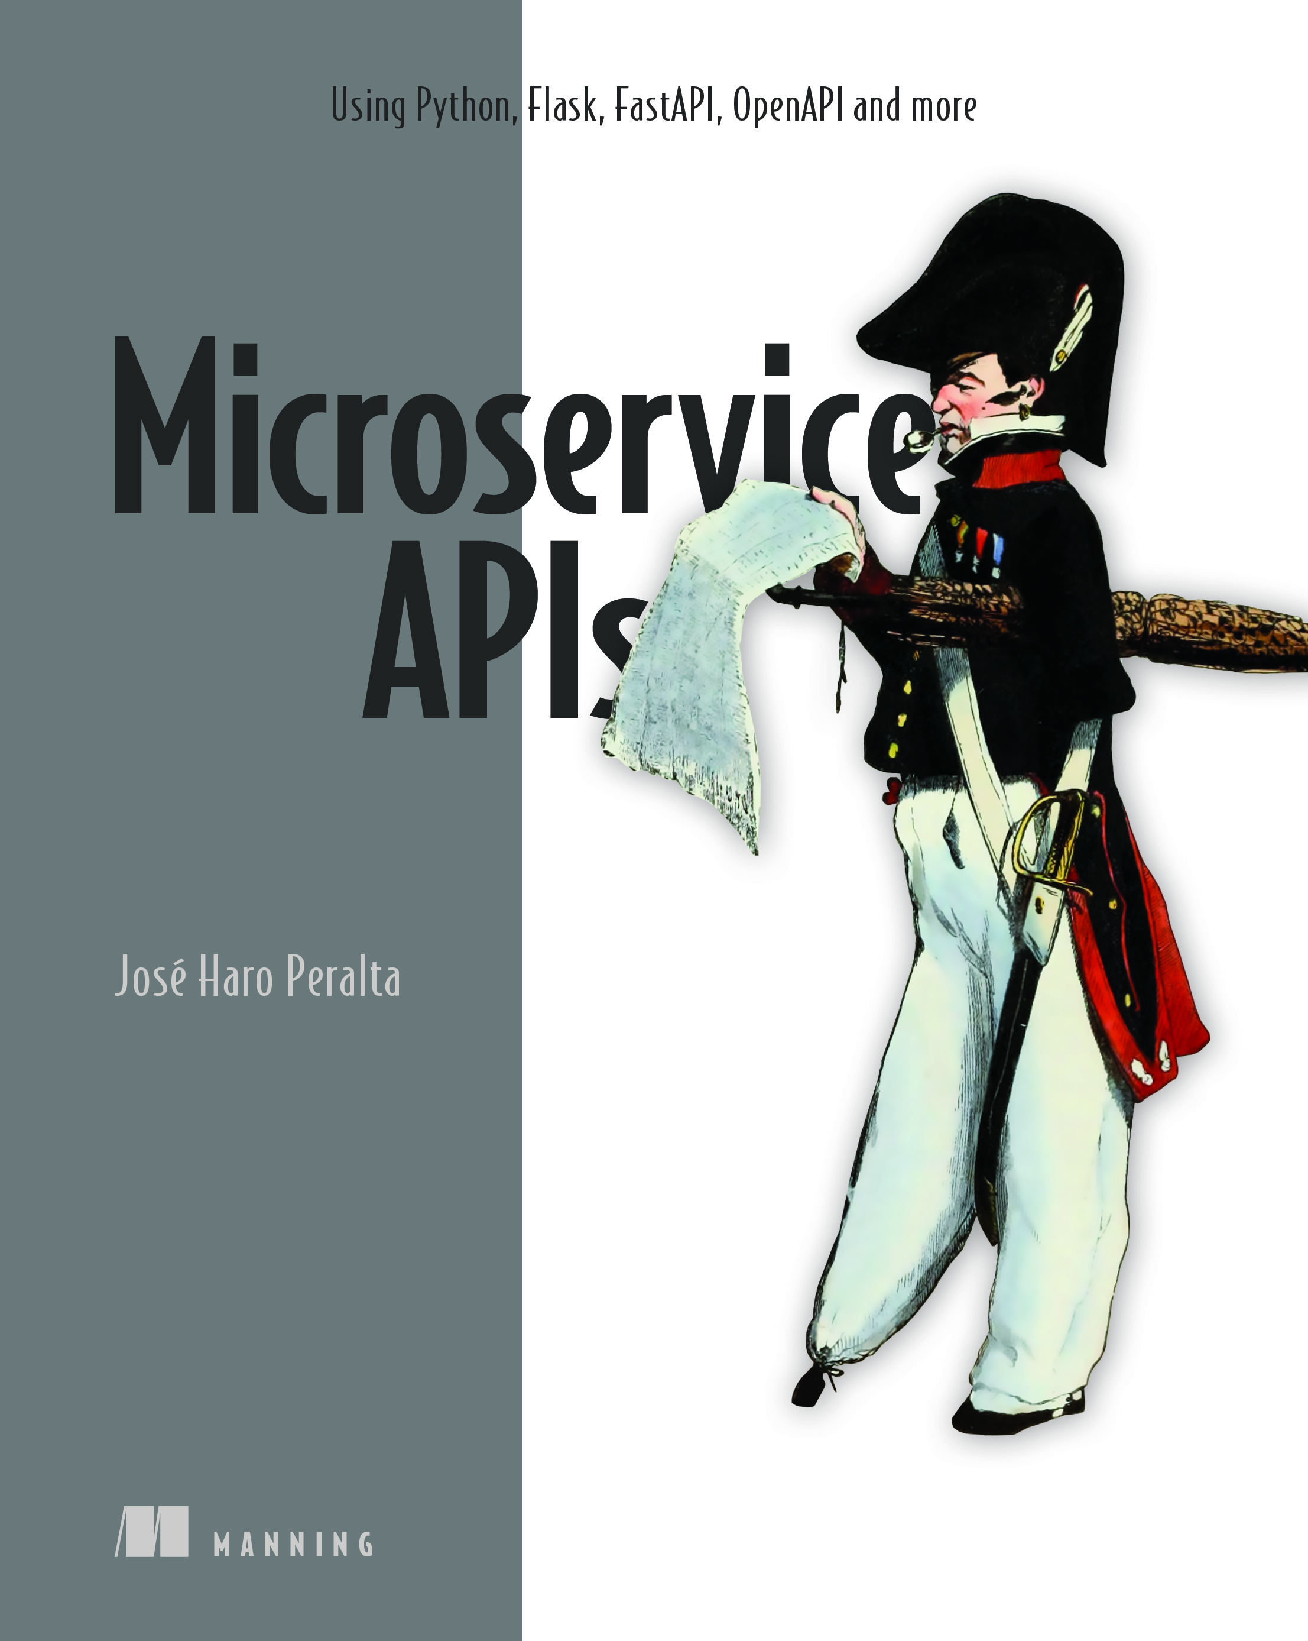
$ whoami
I’m Jose
Consultant at microapis.io
Courses: https://learn.microapis.io
Author of Microservice APIs
Creator of fencer

Slide 5
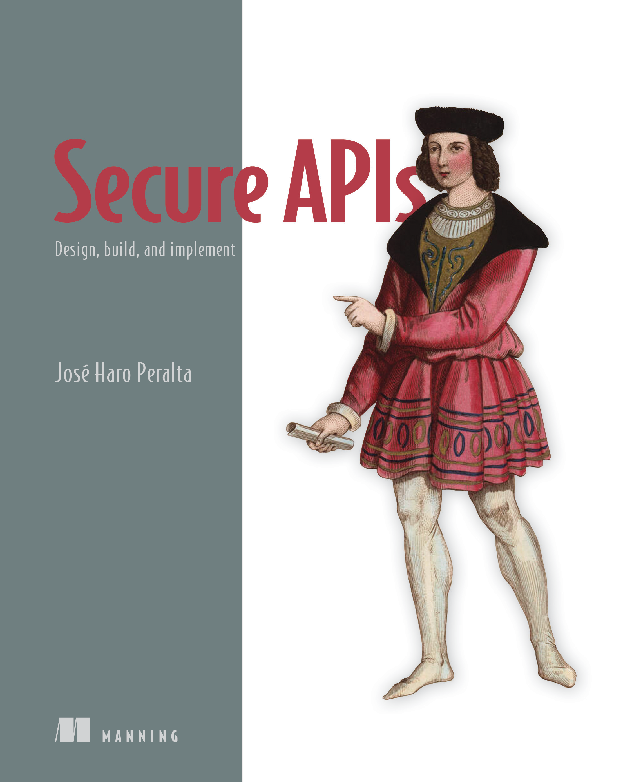

New book! Secure APIs
50% discount code: pyconus50
Valid until May 31, 2024

Slide 6
Connect with me!
Twitter: @JoseHaroPeralta
YT: @microapis
Email: jose@microapis.io
GitHub: @abunuwas
Newsletter: https://microapis.substack.com
LinkedIn: https://www.linkedin.com/in/jose-haro-peralta/

Slide 7
Agenda
Introduction and current state of API security
API authentication and authorization
Working with JWTs
OWASP top 10 API threats
API security testing

Slide 8
What are APIs?
APIs are interfaces to our web services that are designed to allow us to interact with them programmatically.

Slide 9
What is API security?
API security is the practice of securing our APIs and ensuring all user interactions are safe.
Securing APIs requires hardening the design, improving the user flows, validating the implementation, revising our architecture, etc.

Slide 10
Why is API security important?
APIs are prevalent
57% of Internet traffic goes through APIs (Cloudflare, 2024 API Security & Management Report)
API attacks grew by 400% in the past Q1 2023 (Salt Security, State of API Security Q1 2023)
APIs are the main attack vector (Gartner, 2022)

Slide 11
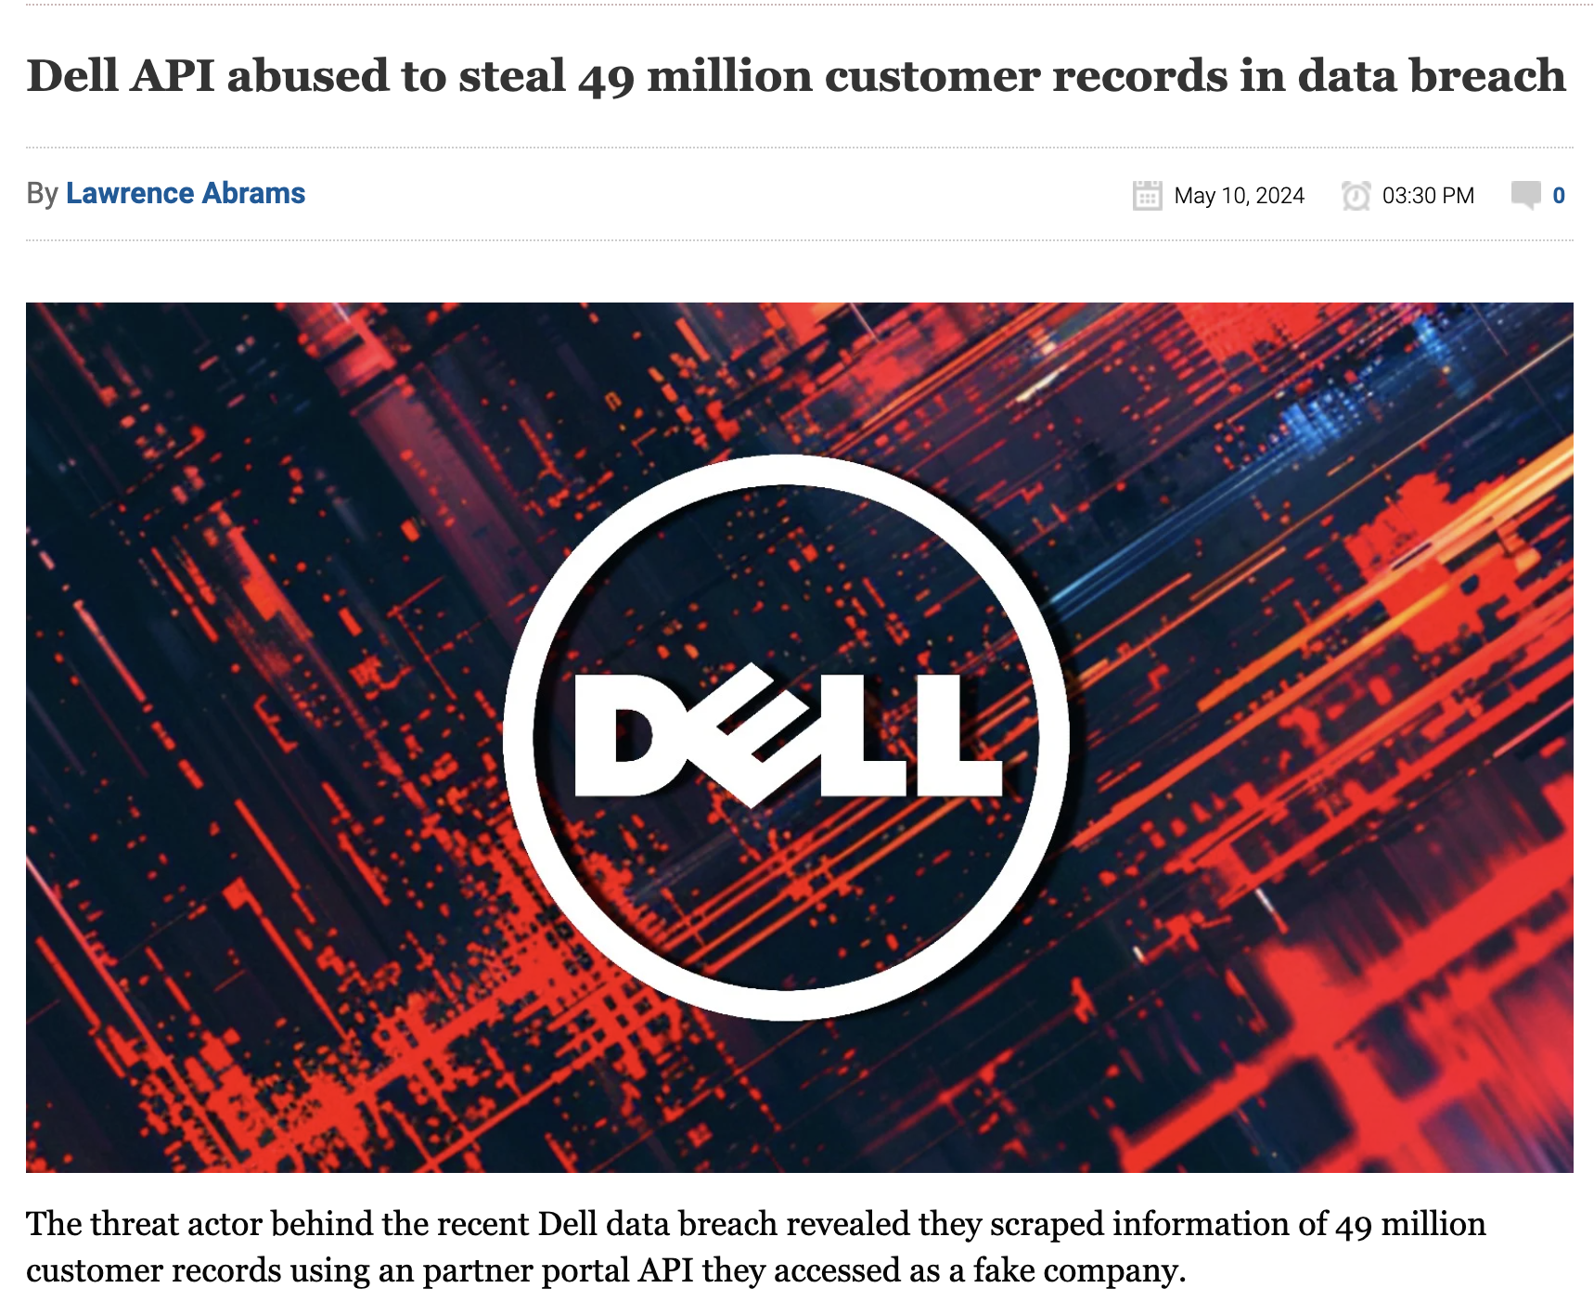
APIs are easy targets

Slide 12
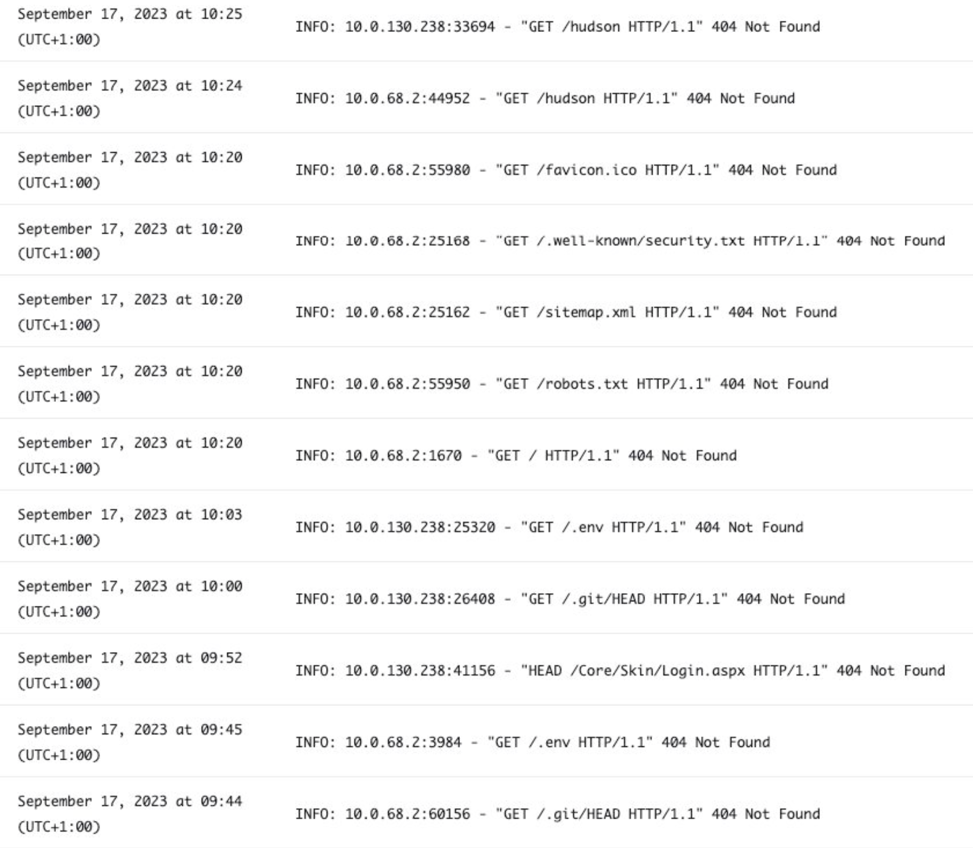

Slide 13
API security is different
In traditional web applications, frameworks like Django and Ruby on Rails do a lot of heavy lifting in security (CSRF tokens, sessions, etc.)
With APIs, security is on you (OAuth flows, token validation, data models, etc.)
OWASP list of API threats launched in 2019 (updated in 2023)

Slide 14
API security is difficult
78% of attacks are authenticated and look like legitimate users (Salt Security, State of API Security Report, Q1 2023)
Most API vulnerabilities are due to business logic flaws (27% of attacks, Imperva, State of API Security in 2024 Report)
It’s easy to expose vulnerabilities through the design

Slide 15
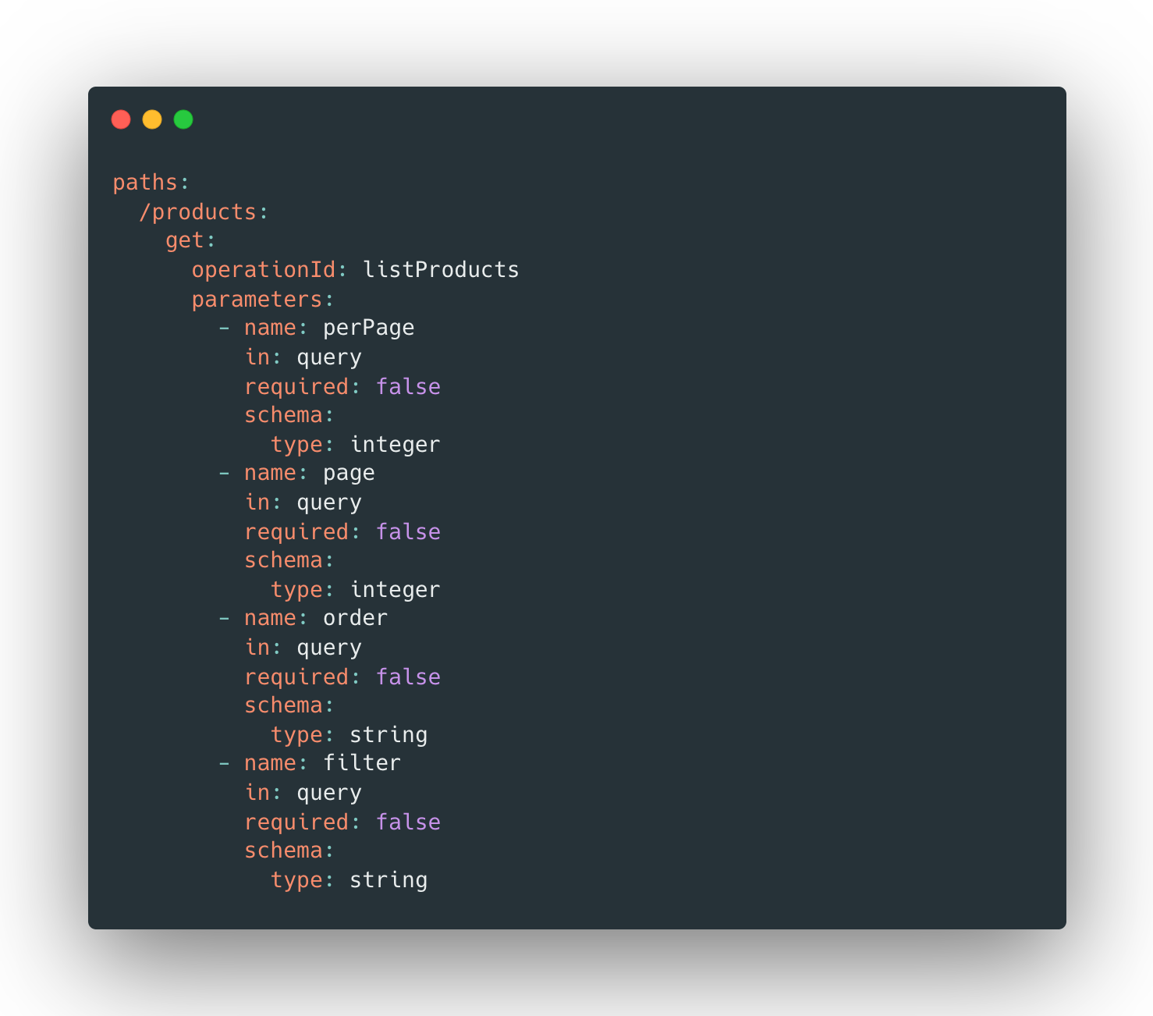

Slide 16
GET /products
GET /products?perPage=10&page=1
GET /products?filter=toasters
GET /products?order=reviews

Slide 17
GET /products?perPage=10000000

Slide 18
GET /products?filter='; DROP TABLE users --

Slide 19
We need to rethink API security
API security is everybody’s job (not a single team, like cybersecurity)
API security starts at the beginning of our API journey (it’s not a last-minute check)
We must address API-specific security issues (not just standard cybersecurity problems)
Design
Implement
Deploy
Test
Security test

Slide 20
API security by design
API SECURITY BY DESIGN is an approach to API security that shift lefts our security strategy by incorporating security concerns from the design.
We incorporate security into every step of the API development cycle to ensure our implementation and delivery process is safe and secure.

Slide 21
Golden rule of API security by design
You can’t protect what you don’t know.
API security 101 is document your APIs accurately with a formal specification like OpenAPI.
Formal specifications can be tested.
Accurate documentation is the easiest way to detect design vulnerabilities.

Slide 22
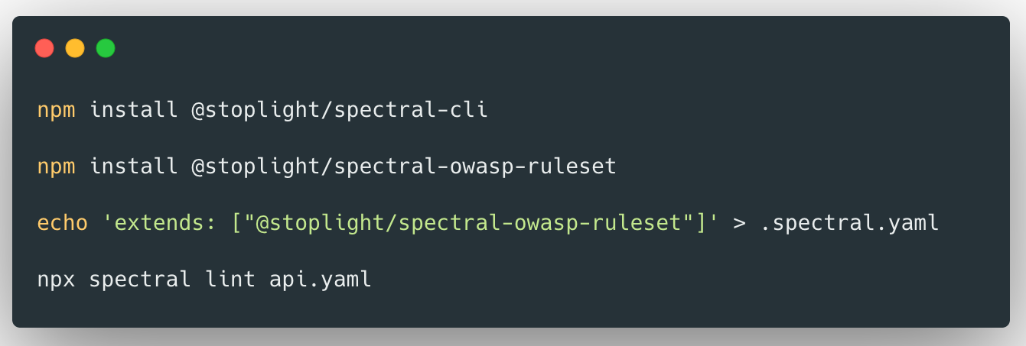
Exercise – run spectral against your API

Slide 23
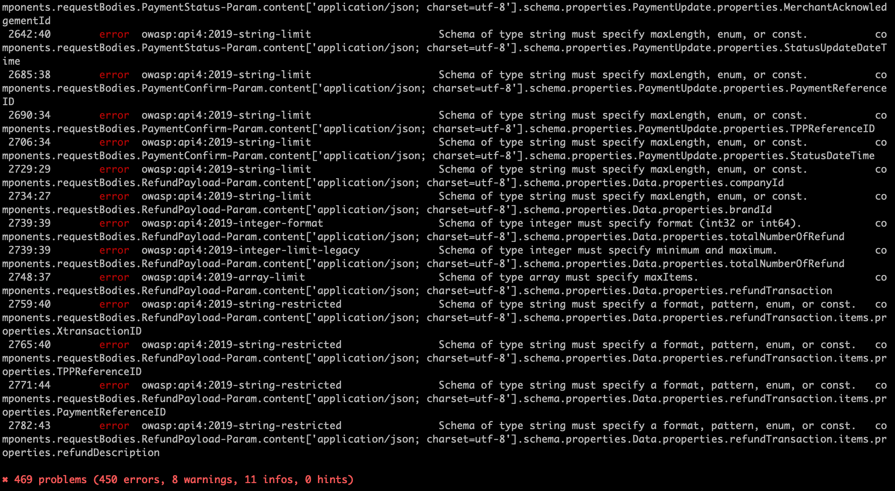
NatWest’s Payit API

Slide 24
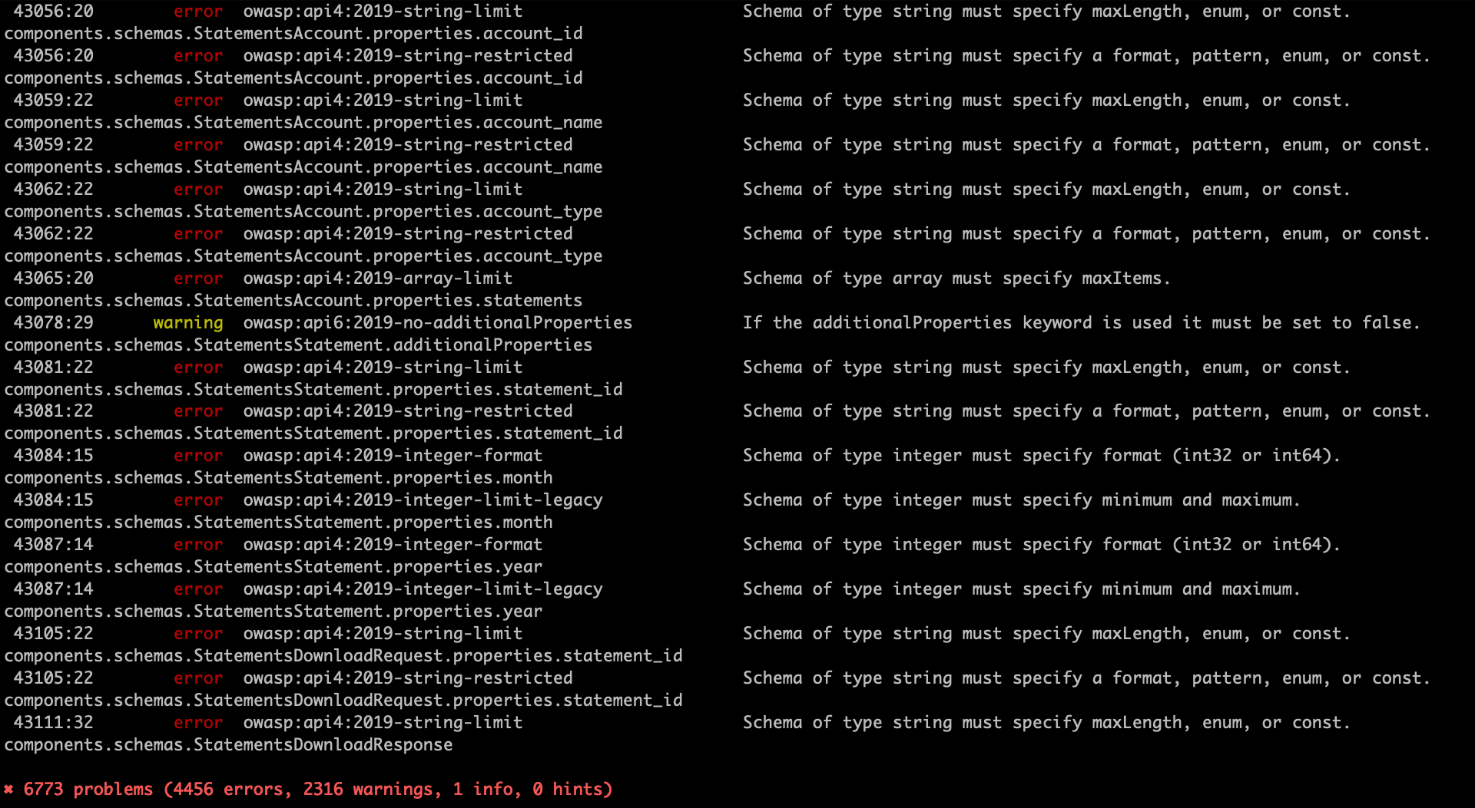
Plaid

Slide 25
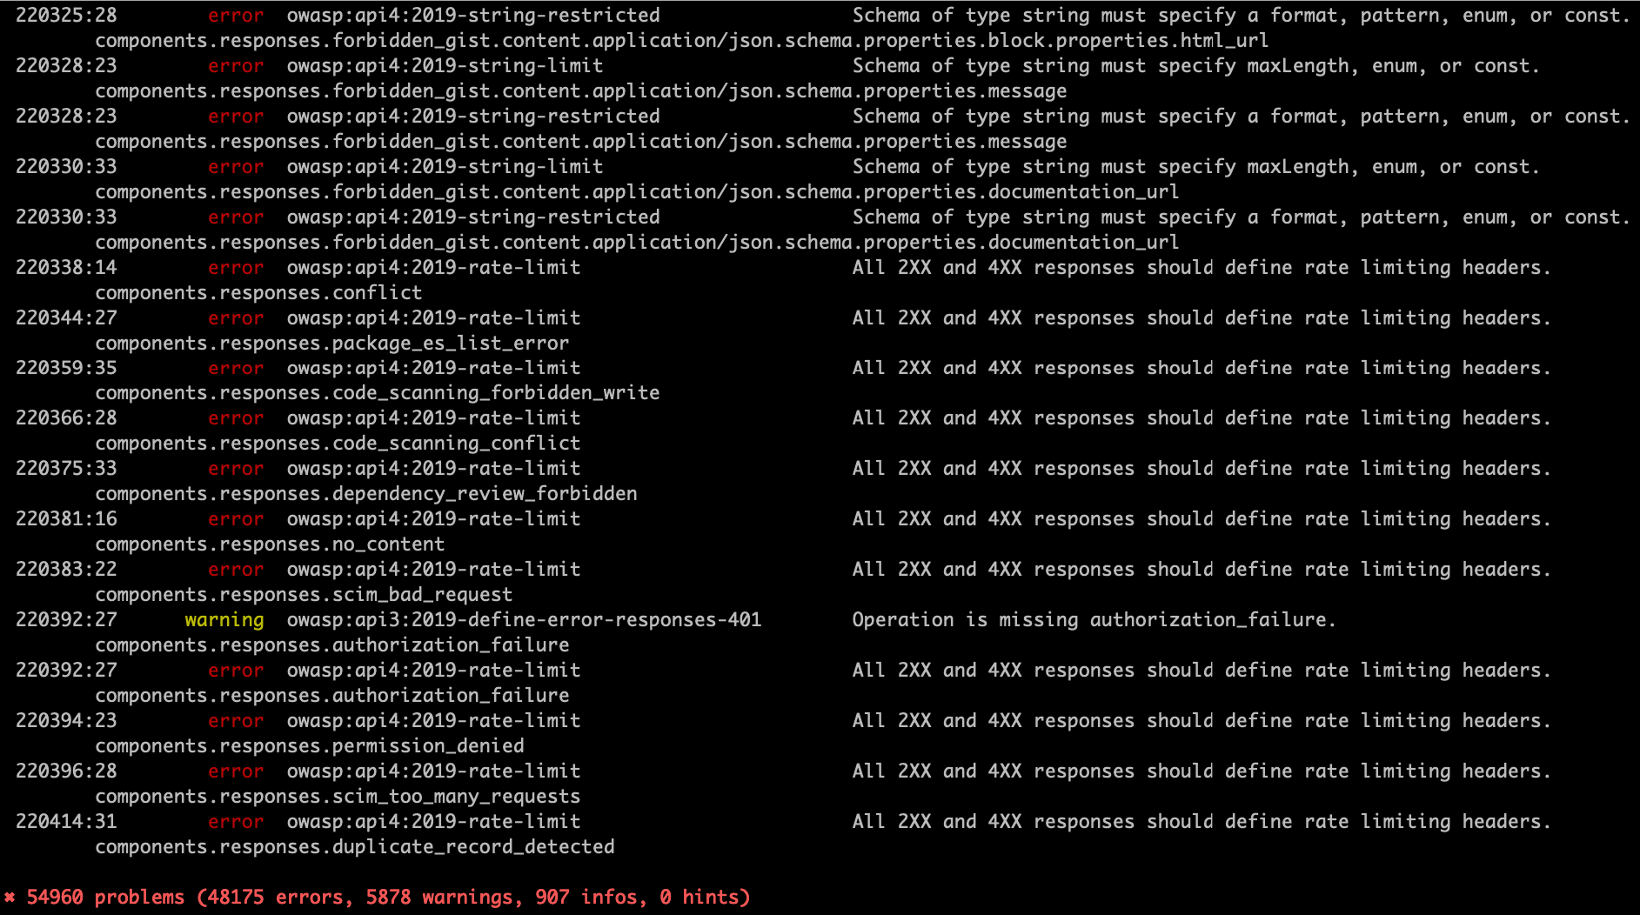
GitHub

Slide 26
Agenda
Introduction and current state of API security
API authentication and authorization
Working with JWTs
OWASP top 10 API threats
API security testing

Slide 27
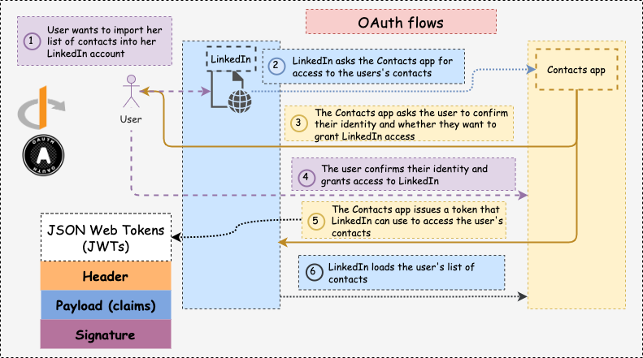
Authentication vs Authorization
Authentication is the process of verifying a user identity, while authorization is the process of verifying that they have access to something.

Slide 28
Exercise – register and login with crAPI
Register and log in with crapi: http://crapi.apisec.ai/
Go to jwt.io and check the token

Slide 29
Open Authorization (OAuth)
OAuth is a standard for access delegation.
Resource owner
Resource server
Client
Authorization server

Slide 30
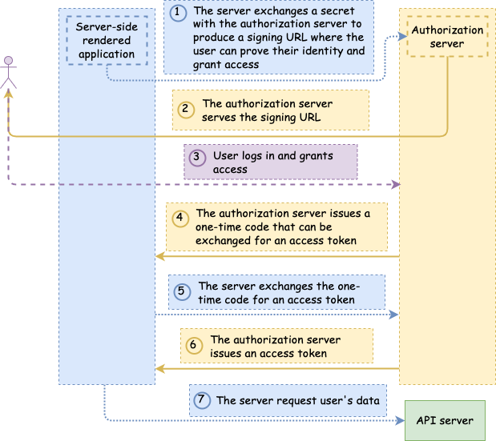
OAuth flows: Authorization code flow

Slide 31
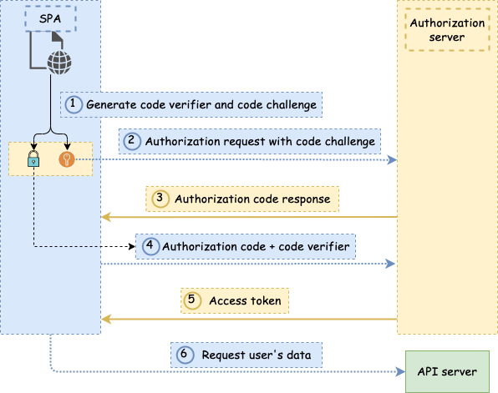
OAuth flows: PKCE flow

Slide 32
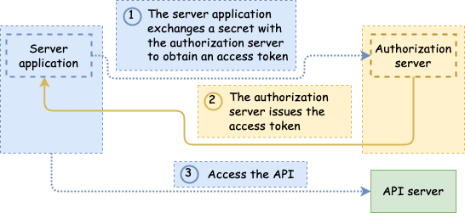
OAuth flows: Client credentials flow

Slide 33
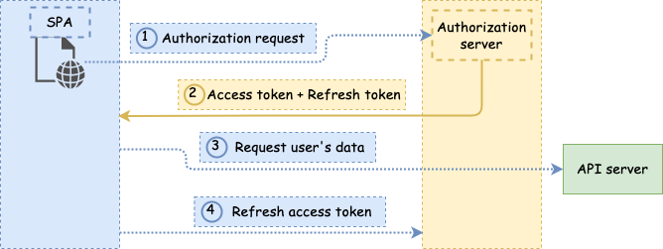
OAuth flows: Refresh Token Flow

Slide 34
Exercise – authorization code flow
Set up in auth0
Clone repo and run the server
Add client_id, client_secret, and authorizer_url
Get a token and inspect its contents
Add scopes: offline_access, and then oidc profile email

Slide 35
Home assignment (voluntary)
Create your own Auth0 tenant and implement auth with it. Or pick up another identity provider!
Implement the refresh token flow

Slide 36
OpenID Connect (OIDC)
OpenID Connect (OIDC) is an open authentication protocol built on top of OAuth that allows users to authenticate on a website using a third-party provider.

Slide 37
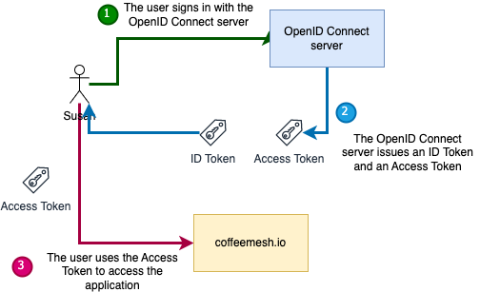
OpenID Connect (OIDC)

Slide 38
Agenda
Introduction and current state of API security
API authentication and authorization
Working with JWTs
OWASP top 10 API threats
API security testing

Slide 39
JSON Web Tokens (JWTs)
JSON Web Tokens (JWT, pronounced ‘JOT’) are JSON documents that contain information about a user. We call the properties of a JWT claims. Two types:
ID tokens
Access tokens
(Encrypted tokens – JSON Web Encryption – JWE)

Slide 40
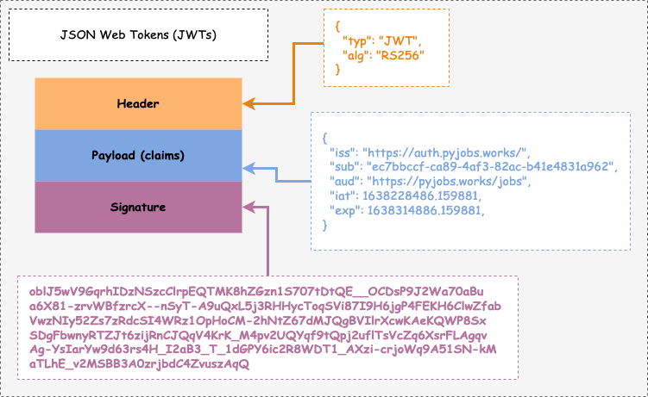
Structure of a JWT

Slide 41
JWT claims – registered claims
iss (issuer)
sub (subject)
aud (audience)
exp (expiration date)
nbf (not before time)
iat (issued at time)
jti (JWT ID)

Slide 42
Exercise – issuing JWTs [with HS256]
Issue a token with python-jose

Slide 43
Exercise – validating JWTs
Validate the previously issued token with python-jose

Slide 44
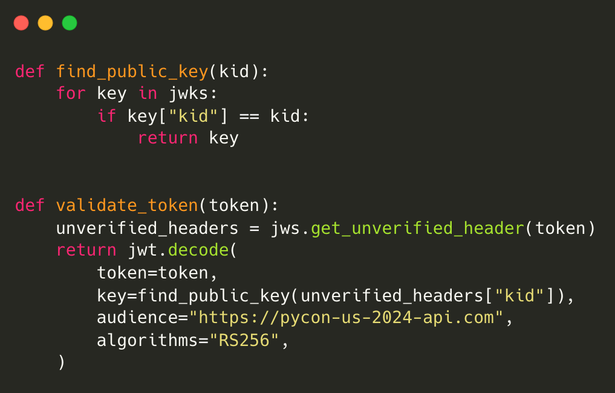
Exercise – validating JWTs from Auth0

Slide 45
Agenda
Introduction and current state of API security
API authentication and authorization
Working with JWTs
OWASP top 10 API threats
API security testing

Slide 46
The OWASP top 10 [2023]
API1:2023 - Broken Object Level Authorization
API2:2023 - Broken Authentication
API3:2023 - Broken Object Property Level Authorization
API4:2023 – Unrestricted Resource Consumption
API5:2023 – Broken Function Level Authorization
API6:2023 – Unrestricted Access to Sensitive Business Flows
API7:2023 – Server-Side Request Forgery
API8:2023 – Security Misconfiguration
API9:2023 – Improper Inventory Management
API10:2023 – Unsafe Consumption of APIs

Slide 47
Broken Authentication
Broken authentication happens when threat actors bypass our authentication system.
Flaws in the implementation of OAuth flows.
Flawed token validation.
Credential stuffing.

Slide 48
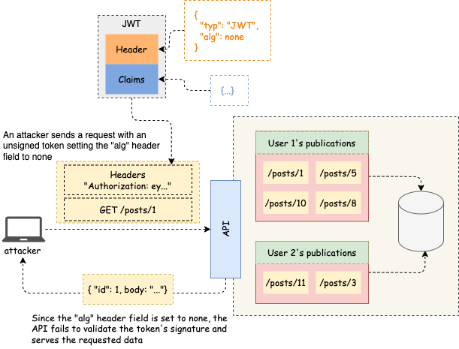
Broken Authentication

Slide 49
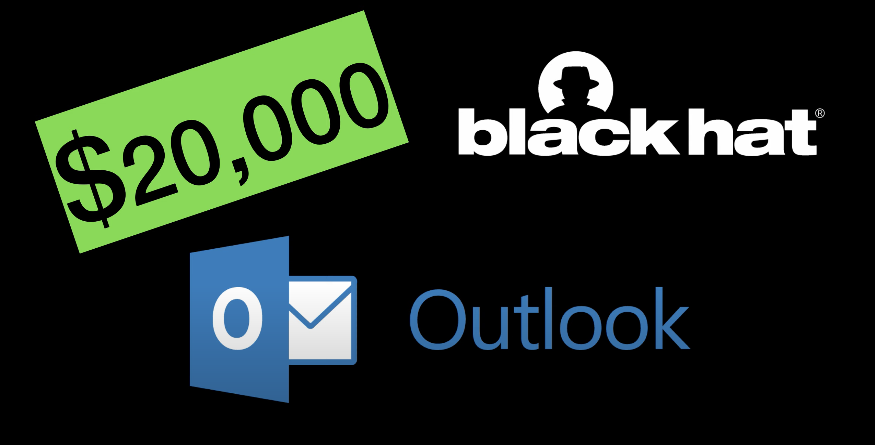
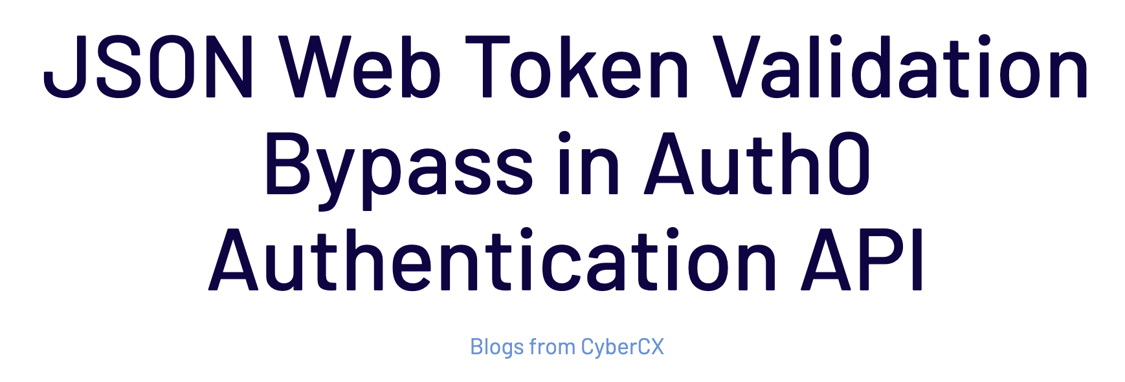
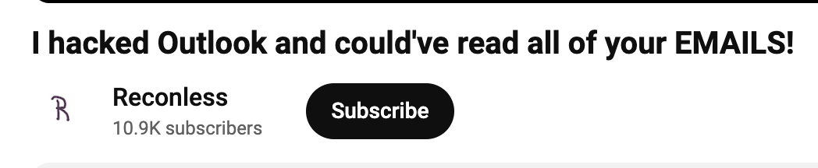
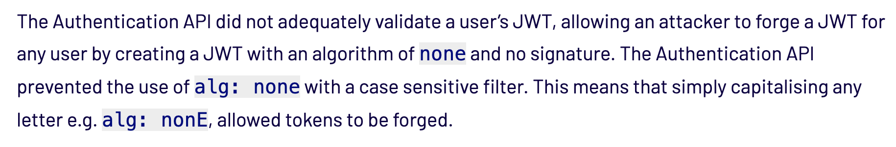
Broken Authentication – examples

Slide 50
Broken Authentication – how to mitigate
Don’t allow unsigned tokens. You know the signature algo – enforce it
Validate all claims
Don’t roll out your own auth

Slide 51
Exercise – add an auth middleware
The orders API doesn’t enforce authentication on any of its endpoints. Using FastAPI’s dependency injection, require valid tokens across all endpoints.

Slide 52
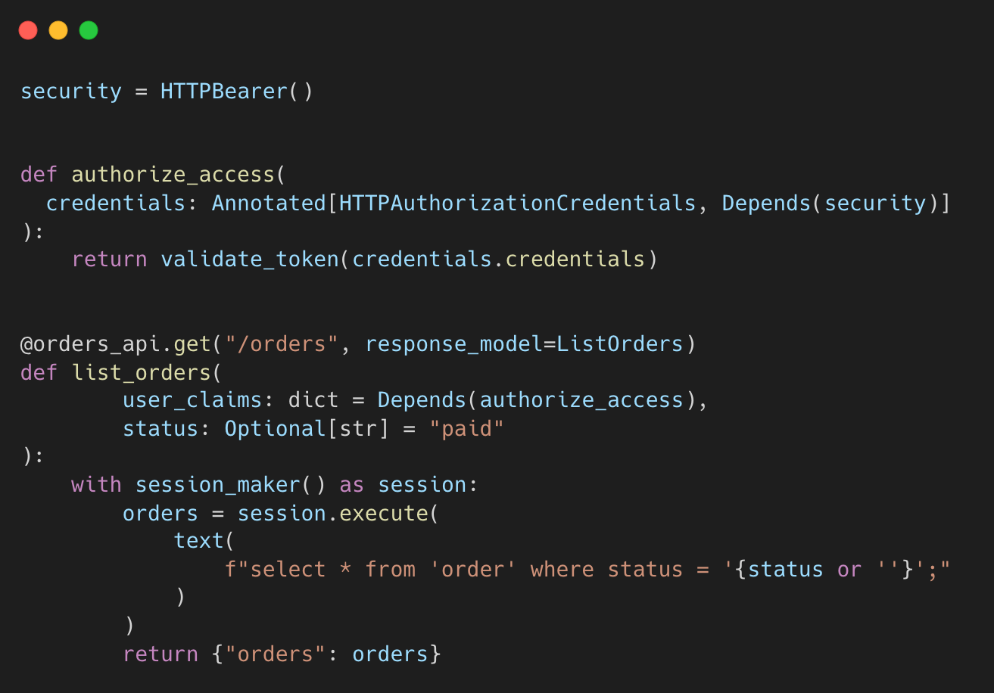

Slide 53
Broken Object Level Authorization
Most APIs have a concept of resource and resource ownership (individual and collective).
For example, user A publishes a post and only they can edit or delete it.
Broken Object Level Authorization happens when user B can edit or delete user A’s posts.

Slide 54
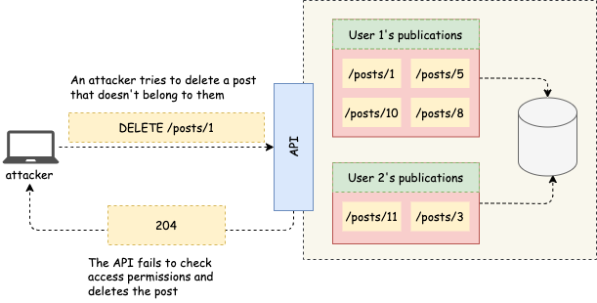
Broken Object Level Authorization (BOLA)

Slide 55
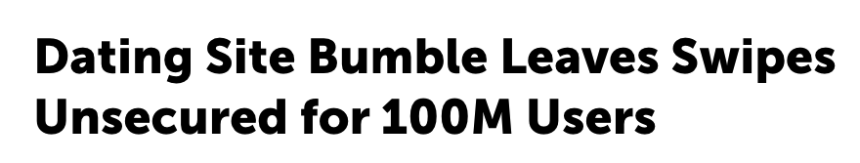
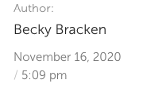
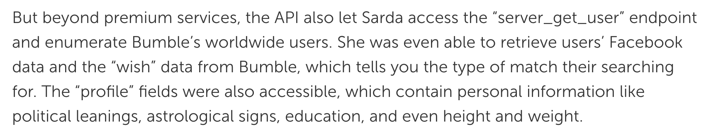
BOLA – examples

Slide 56
BOLA – how to mitigate
Ensure user-based access controls are correctly applied throughout the API.
Write BOLA tests. Even simple tests go a long way.

Slide 57
Exercise – enforce user-based access controls
None of the endpoints in the orders API enforce user-based access controls. Add such access controls across all endpoints.

Slide 58
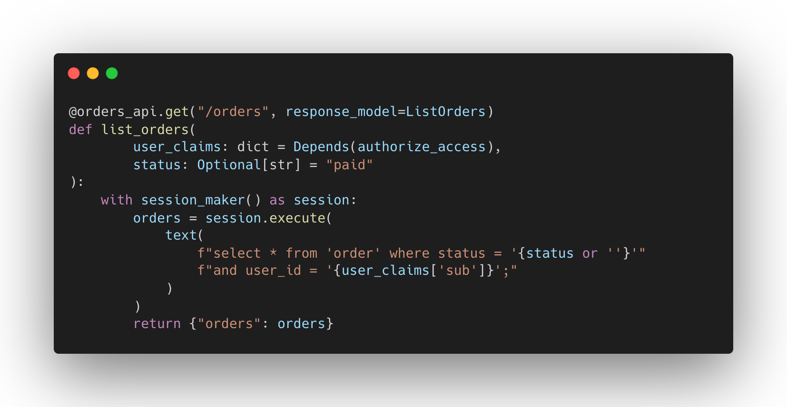

Slide 59
Broken Function Level Authorization (BFLA)
Most APIs have a concept of user groups, roles, or hierarchies.
For example, customers vs developers vs admins (customer API vs developer API etc). Each group has different permissions and access to different operations.
BFLA happens when a user gains access to data or operations that are not accessible to their user group.

Slide 60
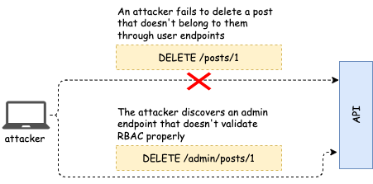
Broken Function Level Authorization (BFLA)

Slide 61
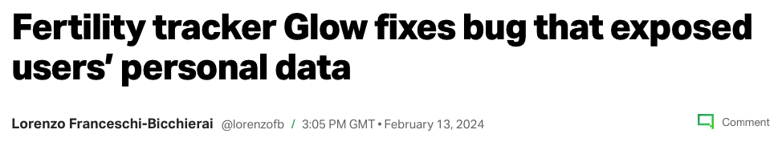
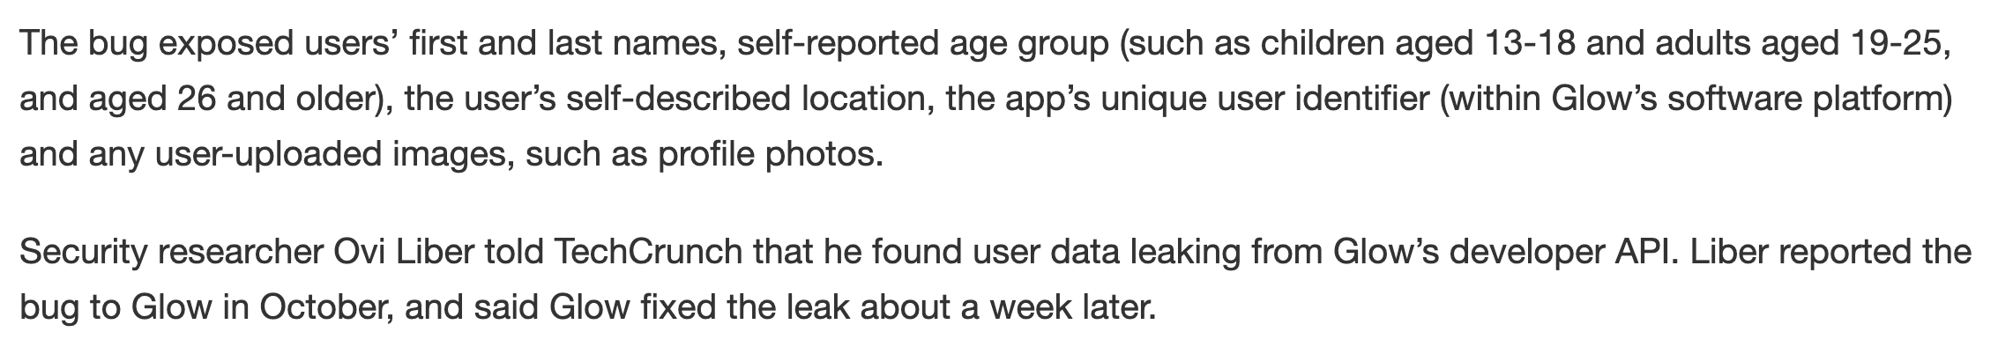
BFLA – examples
25 million users affected

Slide 62
BFLA – how to mitigate
Role-based access controls (RBAC): Include roles in the access token and validate them.
Attribute-based access controls (ABAC): Use simple user attributes to determine access and enforce them.

Slide 63
Exercise – prevent unauthorized access to admin API
The orders API has an admin endpoint. Right now anyone can access the endpoint. Ensure only users with an admin role can access it.

Slide 64
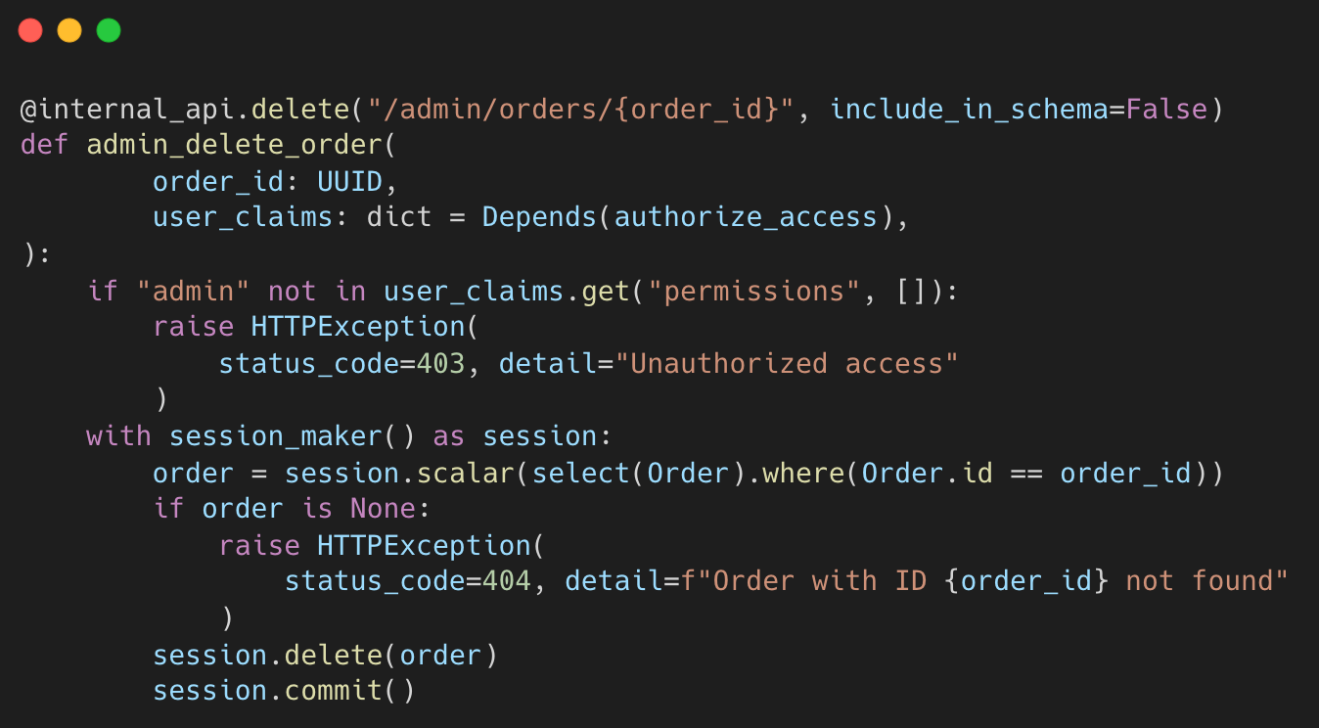

Slide 65
Broken Object Level Authorization (BOPLA)
BOPLA refers to a threat actor’s ability to access properties of an object they shouldn’t have access to.
BOPLA brings together two categories:
Mass assignment
Excessive data exposure

Slide 66
Mass Assignment
Most APIs have a concept of server-side or read-only properties, like IDs and creation date. Also sensitive information like payment status and such.
Mass assignment happens when a user manages to override a server-side or read-only property.

Slide 67
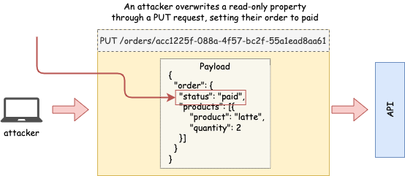
Mass Assignment (BOPLA)

Slide 68
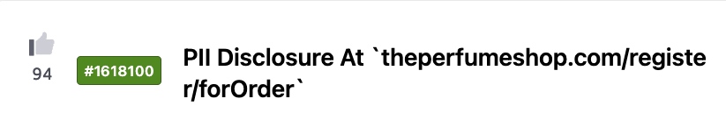
Mass Assignment – examples
A. S. Watson Group
Vulnerability: threat actor could change email and password associated with an order

Slide 69
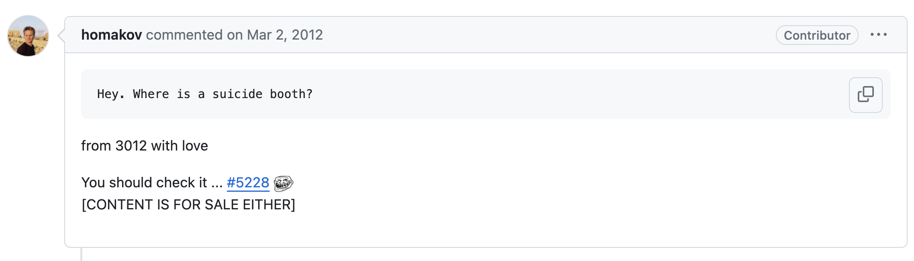
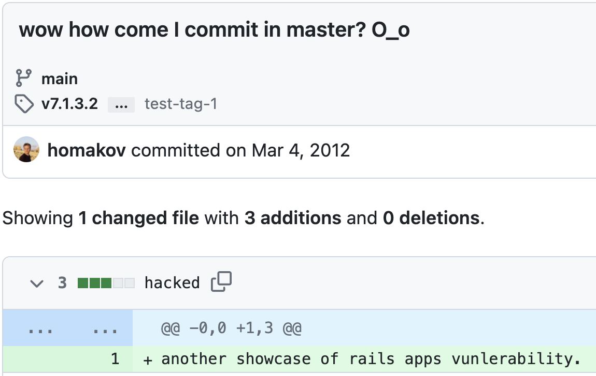

Slide 70
Mass Assignment – how to mitigate
Constrain user input as much as possible
Use strict schemas
Only capture the expected fields from the request payload

Slide 71
Exercise – prevent mass assignment when updating an order
The PUT /orders/{order_id} endpoint is vulnerable to mass assignment. Fix this vulnerability.

Slide 72
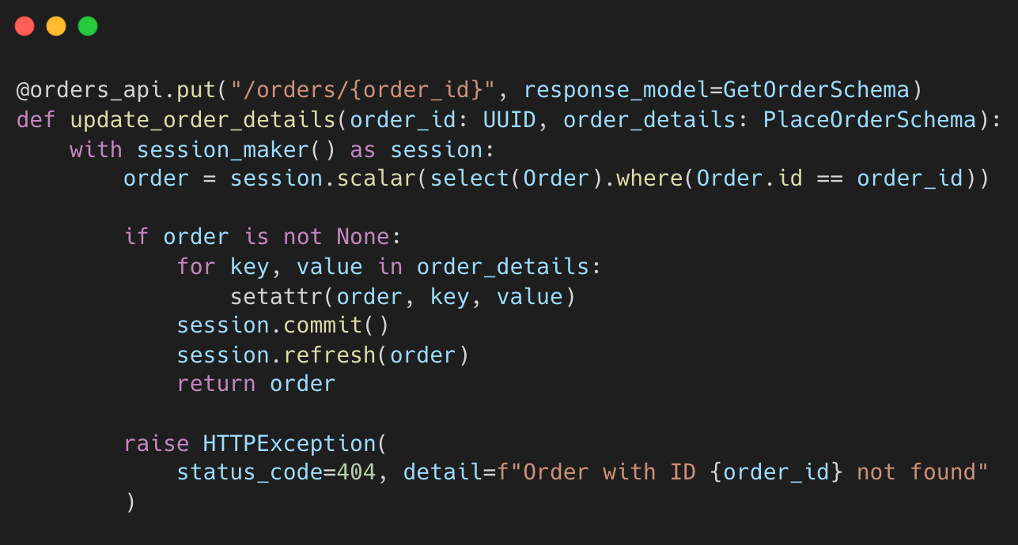

Slide 73
Excessive data exposure
Excessive data exposure happens when our API exposes unnecessary information.
E.g. when we expose unnecessary PII (personal identifiable information)
E.g. when we expose unnecessary IDs.

Slide 74
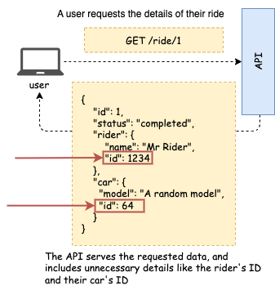
Excessive Data Exposure (BOLA)

Slide 75
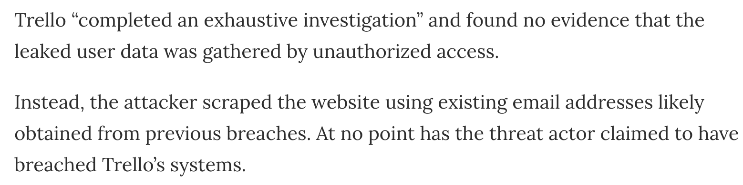
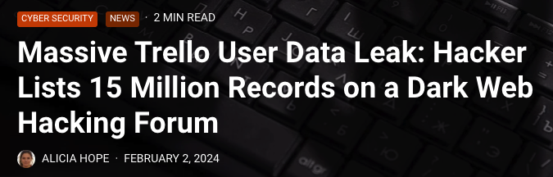
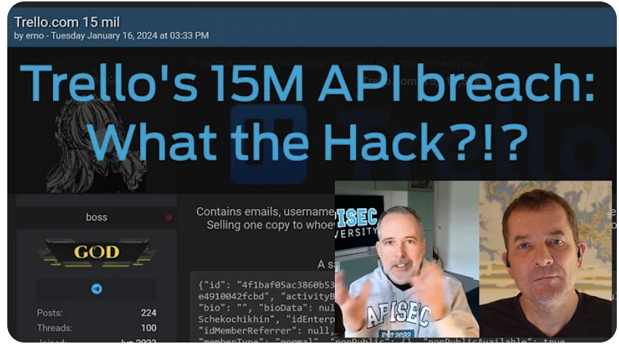
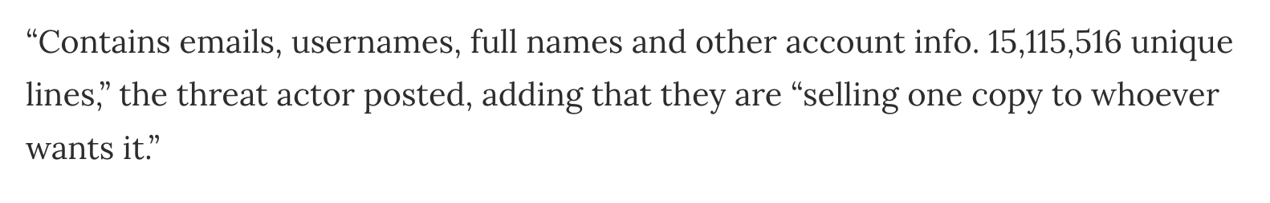
Excessive data exposure – examples

Slide 76
Excessive data exposure
Don’t expose data that the consumer doesn’t need.
Don’t correlate your database models to your response models.
Don’t expose sensitive data through unauthenticated endpoints
"Remember, when designing your Web API, your data model is not your object model is not your resource model is not your message model." — Mike Amundsen (https://www.amundsens-maxim.com/)

Slide 77
Exercise – prevent leak of exclusive deals
The GET /products endpoint contains some exclusive deals that shouldn’t be visible to our user. Filter out all deals requiring more than 600 loyalty points.

Slide 78
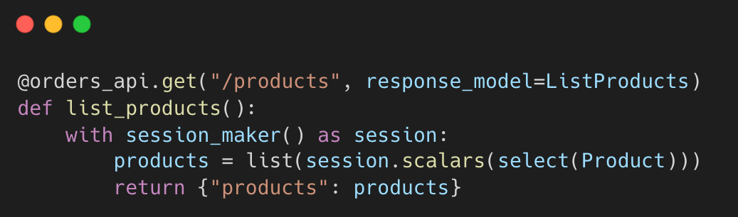

Slide 79
Unrestricted access to sensitive business flows
It occurs when threat actors can run automated abuse against our core business flows through the API.
E.g. buying out the whole stock of a product and reselling it at a higher price (scalping)
E.g. fake referrals to earn coupons or other benefits.

Slide 80
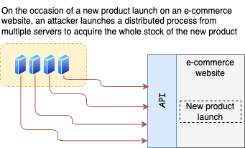
Unrestricted Access to Sensitive Business Flows

Slide 81
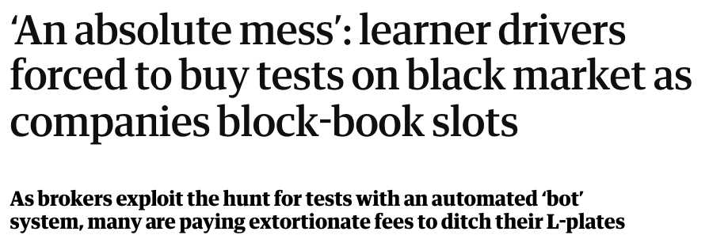
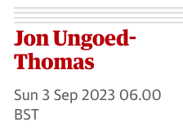
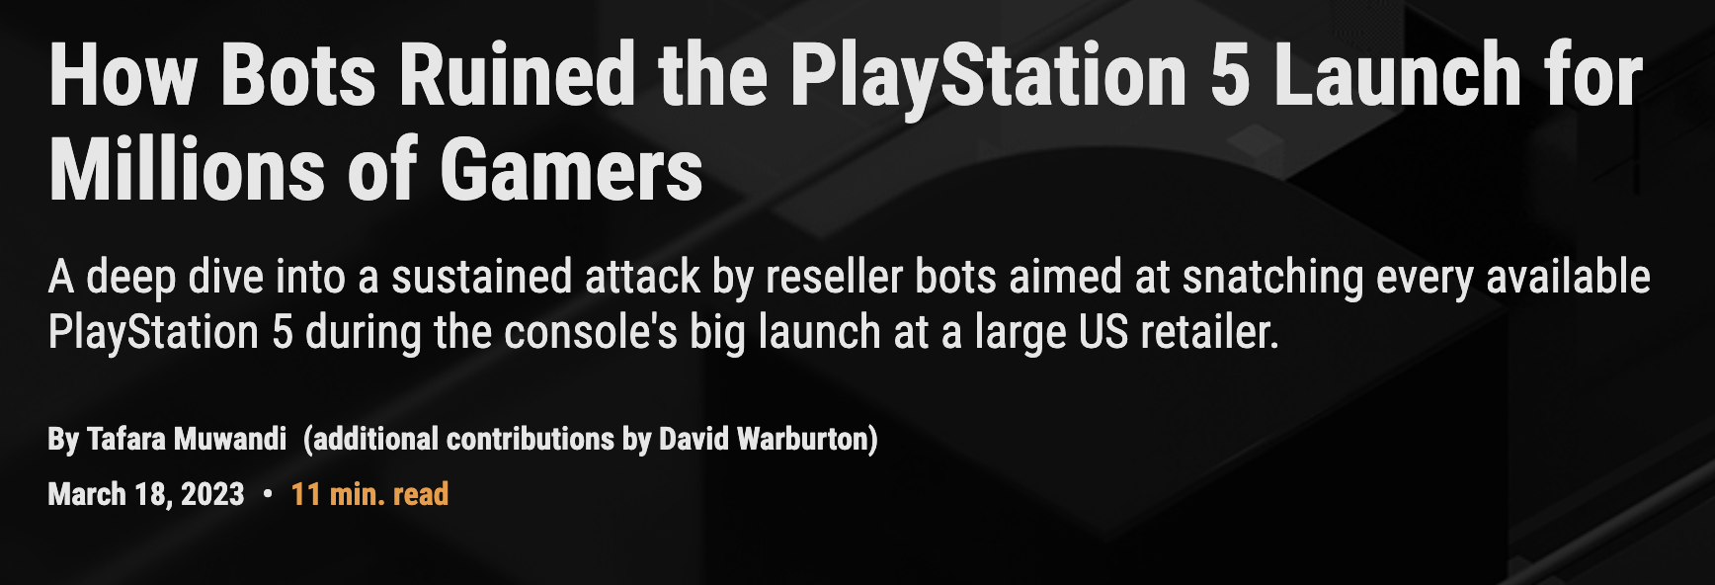
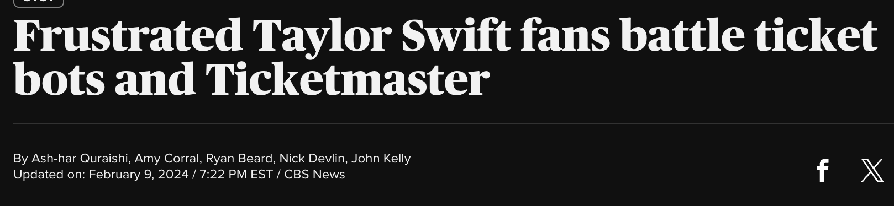
Unrestricted access to sensitive business flows – examples

Slide 82
Unrestricted access to sensitive business flows – how to mitigate
Don’t expose sensitive business flows through unauthorized endpoints
Breakdown the flow into traceable steps, enforce a sequence, and track the timing between steps
Use CAPTCHA and CSRF tokens if applicable
Rate-limit the requests
Constrain user operations, e.g. limit the number of tickets or products they can buy in one go etc.

Slide 83


Slide 84
Exercise – prevent users from buying the whole stock of a product
The POST /orders endpoint allows unfettered access to malicious users. Make sure they can only place one order per day and limit the number of items they can buy in one go.

Slide 85
Injection
Injection happens when threat actors inject malicious code, commands, or database statements into our system.
Happens through input parameters such as request payloads, query and path parameters, headers, etc.

Slide 86

Injection

Slide 87

Injection – examples

Slide 88
Injection – how to mitigate
Constrain user input as much as possible
Parametrize all database queries

Slide 89
Exercise – prevent SQL injection
The GET /orders endpoint is vulnerable to SQL injection through the status parameter. Fix this vulnerability.

Slide 91
Server-side request forgery (SSRF)
SSRF is the ability to run malicious requests from our servers.
Happens through URL input, like user profile pictures, webhooks, etc.
Allows threat actors to discover internal services, leak credentials, etc.

Slide 92


Server-Side Request Forgery (SSRS)

Slide 93




Server-side request forgery (SSRF) – examples

Slide 94
Server-side request forgery (SSRF) – how to mitigate
Ban requests to your localhost and your local network
If possible, whitelist the allowed domains
Don’t send raw responses to the client

Slide 95
Exercise – prevent SSRF in the orders API
We have an endpoint that allows you to submit a URL and pull its content. The endpoint is vulnerable to SSRF attacks, e.g. for scanning the local network. Ban request to the localhost to prevent this issue.

Slide 96


Slide 97
Unsafe consumption of APIs
Most applications rely on third-party API integrations, e.g. for emailing, payments, geolocation, user details, etc.
External APIs can also be vulnerable to injection, data poisoning, etc.
When we consume data and services from external APIs, we are exposed to their risks and vulnerabilities.

Slide 98

Unsafe Consumption of APIs

Slide 99



Unsafe consumption of APIs – examples

Slide 100
Unsafe consumption of APIs – how to mitigate
Validate responses from third-party APIs against their published schemas
Sanitize data coming from third-party APIs
Parametrize queries involving external data

Slide 101
Security misconfiguration
Security misconfiguration refers to the incorrect configuration of our services
E.g. running in DEBUG mode, exposing unnecessary HTTP methods, unauthenticated services, exposing private APIs to the Internet, etc.

Slide 102

Security Misconfiguration

Slide 103


Security misconfiguration – examples

Slide 104
Security misconfiguration – how to mitigate
Ensure all flags and configuration modes are correctly set
Don’t leak stack traces -> capture exceptions and return standard error responses
Add secure headers like rateLimit
Enable authentication where needed

Slide 105
Improper asset management
Assets refers to our surface attack, such as endpoints and API versions. Improper asset management refers to the improper management of our attack surface.
E.g. failing to retire a deprecated version.
API sprawling
Shadow APIs
Ghost APIs

Slide 106

Improper Asset Management

Slide 107


Improper asset management – examples

Slide 108
Improper asset management – how to mitigate
Have a process for releasing and deprecating API versions
Use technologies like API Gateways to control your surface attack exposure and manage API versioning

Slide 109
Unrestricted resource consumption
It happens when threat actors gain unfettered access to our resources.
Main types of attacks: DDoS and brute force.
DDoS allows threat actors to shut down our services.
Brute force allows threat actors to break credentials.

Slide 110

Unrestricted Resource Consumption

Slide 111


Unrestricted resource consumption – examples

Slide 112




Unrestricted resource consumption – examples

Slide 113



Slide 114


Slide 115
Unrestricted resource consumption – how to mitigate
Implement rate-limiting measures
Restrict how many resources a process has access to, e.g. max CPU and memory
Add limits to payload size
Configure auto-scaling limits

Slide 116
Agenda
Introduction and current state of API security
API authentication and authorization
Working with JWTs
OWASP top 10 API threats
API security testing

Slide 117
API security testing strategies
Design testing: we test the API specification for vulnerabilities. This is the foundational step for security-by-design. It requires a highly accurate and detailed API specification.
Runtime testing: it the API implementation against a live server. It ensures the API is correctly implemented and highlights vulnerabilities not caught at design-time. Popular approaches include fuzzy testing and OWASP testing.

Slide 118
API security testing tools
Schemathesis: very popular API fuzzy testing tool implemented in Python. It works by taking an API specification and figuring out what tests need to be done to ensure the implementation is correct.
Fencer: API security testing tool implemented in Python.
Spectral: spectral is the most popular API linter. It has an OWASP plugin which can be used to run API security by design tests.

Slide 119

API testing with schemathesis

Slide 120


Slide 121

API testing with schemathesis

Slide 122

Automating API security testing with fencer

Slide 123

Automating API security testing with fencer

Slide 124
Automating API security testing with spectral

Slide 125



Slide 126
Vulnerable API design
https://apivulnerabilities.com
Unbound arrays
Leaking objects
Free-form strings
Sequential IDs
Exposing server-side properties in user input
Flexible schemas with unknown parameters
Too many IDs
Improper pagination
Unbound integers
Unrestricted filters
Flexible schemas with optional parameters
Unclear/implicit RBAC
URL-specific RBAC endpoints
Cluttered endpoints
Endpoint sprawling
Unclear user flows

Slide 127
Sequential IDs
Sequential IDs are one of the most common types of resource IDs.
They’re natively supported by SQL databases.
They’re intuitive and easy to work with.
However, exposing them directly through the API allows malicious users to launch surface attacks.

Slide 128


POST /payments
{"id": 1, …}
{"id": 2, …}
{"id": 3, …}
…

Slide 129

Clubhouse data leak
In April 2021, hackers pulled the public profile of over 1m Clubhouse users
More details: https://apisecurity.io/issue-129-facebook-clubhouse-profiles-scraped-apis-forresters-state-application-security-2021/

Slide 130
Sequential IDs: how to prevent
Don’t use sequential IDs in your DB - use UUIDs or something similar
Use a hashing function to hide the value of the original ID

Slide 131
Flexible schemas
Flexible schemas are schemas that allow the inclusion of undeclared/unknown or optional properties in the payloads.
Flexible schemas expose the API to the risk of mass assignment (API6:2019) / Broken Object Property Level Authorization (API3:2023) and data corruption.

Slide 132
Flexible schemas - Undeclared properties
Undeclared properties are properties that we haven’t declared as part of the schema.
Mass assignment (OWASP 2019, BOLA in 2023) is a vulnerability that allows malicious users to override properties they shouldn’t be able to modify, like object IDs or the status of a payment.

Slide 133



POST /orders
GET /orders/{id}

Slide 134


POST /orders
GET /orders/{id}

Slide 135



Slide 136
Undeclared properties: how to prevent
Use strict schemas
In OpenAPI < 3.1, you ban undeclared properties by setting additionalProperties to false.
With OpenAPI >= 3.1, you can set unevaluatedProperties to false.

Slide 137

⛔️

Slide 138


Slide 139
Flexible schemas – optional properties
Optional properties are declared properties that are optional in the payload.
Optional properties are often used to give users flexibility, and to represent different models with the same schema.
Optional properties open the door to Mass assignment (OWASP 2019, BOLA in 2023) and data corruption.

Slide 140




Slide 141



Slide 142
Optional properties: how to prevent
Use different schemas to represent different models.
Make each schema strict.
Don’t make core object properties optional.

Slide 143



Slide 144
Unbound parameters
Unbound parameters are parameters that can take on arbitrarily low or large values. It affects numbers, strings, and arrays.
Opens the API to big integer attacks, large payloads, pagination attacks, SQL injection, and many more.

Slide 145
GET /products
GET /products?perPage=10&page=1
GET /products?filter=toasters
GET /products?order=reviews

Slide 146
GET /products?perPage=10000000

Slide 147
GET /products?filter='; DROP TABLE users --

Slide 148
Broken Object Level Authorization (BOLA)
GET /products?filter=' OR 1=1--
GET /products?filter=' OR (CASE WHEN (1=1) THEN (SELECT 1 = 1) ELSE (SELECT 1 = 0) END)

Slide 149
Resource starvation
GET /products?filter=' AND 3133=(SELECT 3133 FROM PG_SLEEP(10))--

Slide 150



REQUEST
RESPONSE

Slide 151



ABUSE OF REVIEW SYSTEM
LARGE PAYLOAD ATTACK

Slide 152


Slide 153
Unbound parameters: how to prevent
Constrain user input: add minimum and maximum numeral values and array length; use enumerations and regular expressions; maximum text length, etc.
Parametrize all database queries

Slide 154
Exposing server-side properties in user input
Server-side/read-only properties are properties that are set and managed by the server. Usually sensitive data like IDs, creation date, or the status of an order or a payment.
Users are not supposed to be able to override those properties. If they do, it’s a BOPLA.
It happens often when we use the same schemas to represent our models in read endpoints and for user input.

Slide 155



REQUEST
RESPONSE

Slide 156



Slide 157



Slide 158
Server-side properties in user input: how to prevent
Use different models for user input and read-only endpoints.
Never expose server-side properties in user input.
Ban additional properties in user input.
Constrain parameters in user input.

Slide 159

https://github.com/SmartBear-DevRel/webinar-security-by-design
https://www.youtube.com/@Smartbear

Slide 160
Thanks for listening!
Twitter: @JoseHaroPeralta
GitHub: @abunuwas
Newsletter: https://microapis.substack.com
LinkedIn: https://www.linkedin.com/in/jose-haro-peralta/

